Slide 1
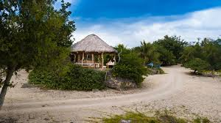
La France, les beaux trésors cachés.

Slide 2
La Campagne
Les films de Marcel Pagnol toujours se déroulent à la campagne.
La gloire de mon père (video)
Manon de source (video)

Slide 3
Quelques films qui apprécient la beauté de la campagne :
Le bonheur est dans le pré
Le papillon (video)

Slide 4
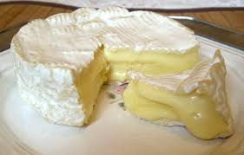
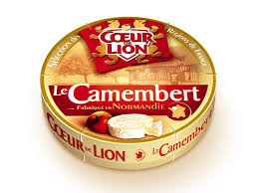
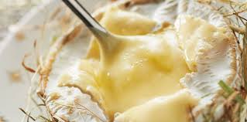
Les fromages les plus connus
Camembert

Slide 5
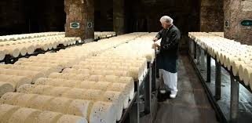
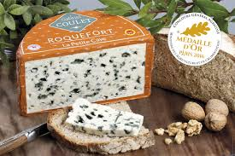
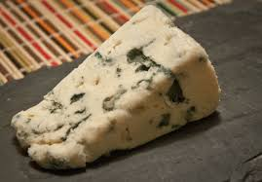
Les fromages les plus connus . continued….
Roquefort

Slide 6
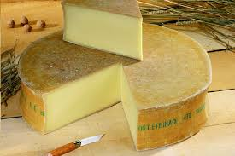
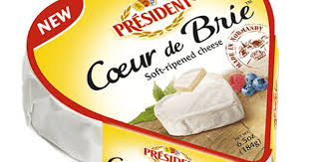
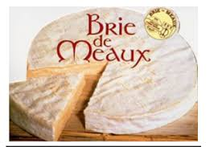
Les fromages les plus connus . continued….
Brie

Slide 7
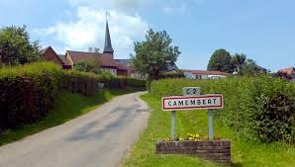
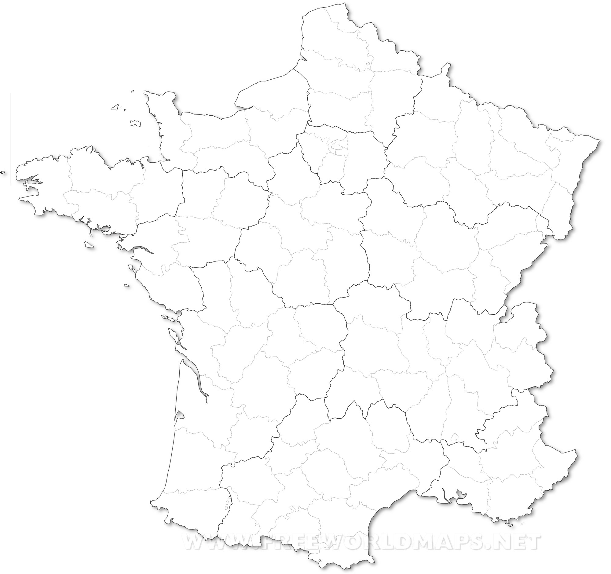
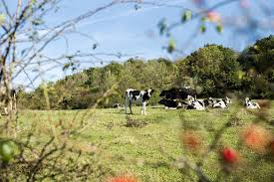
The cheeses named after their regions
Brie
Camembert
Roquefort- sur -Soulzon

Slide 8
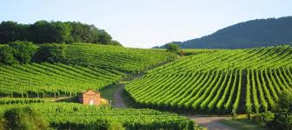
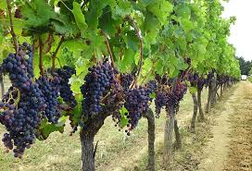
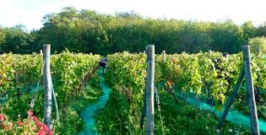
Les vignobles

Slide 9
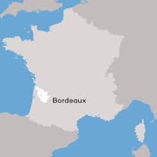
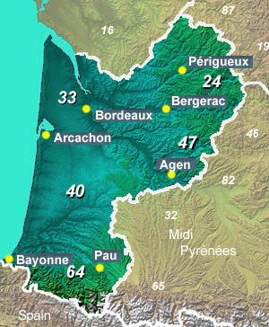
Les vignobles dans la région Bordeaux
Lying in the southwestern corner of France, Old Aquitaine, the former region of Aquitaine, is an area famed for its wine, its beaches and its countryside.

Slide 10
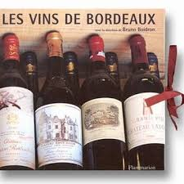
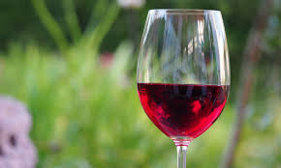
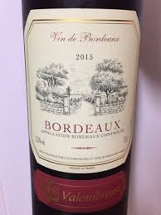
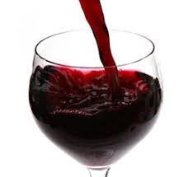
Le vin : Bordeaux

Slide 11
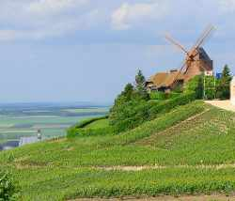
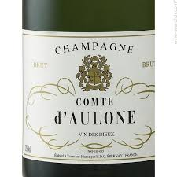
Les vins de Champagne

Slide 12
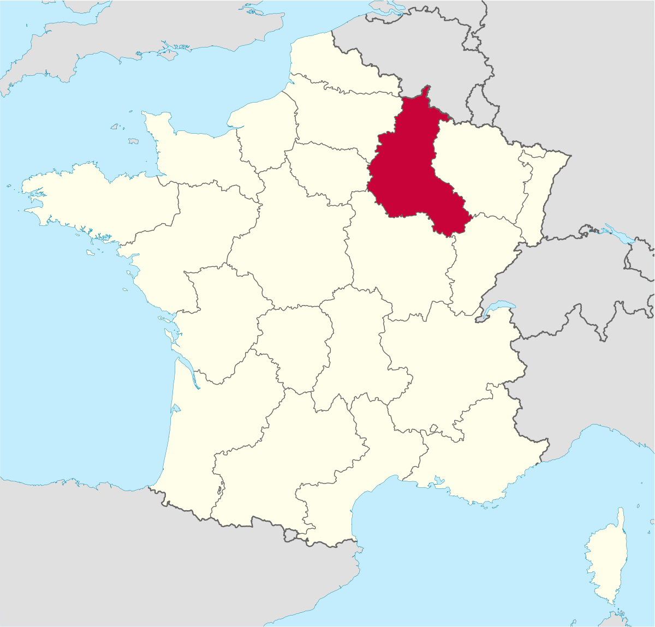
Champagne region :situated in the northeast of France between Paris and Belgium.

Slide 13
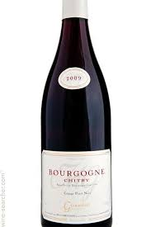
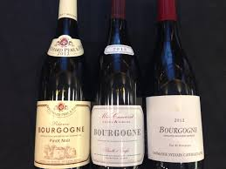
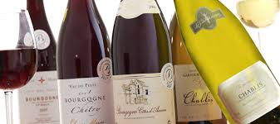
Bourgogne

Slide 14
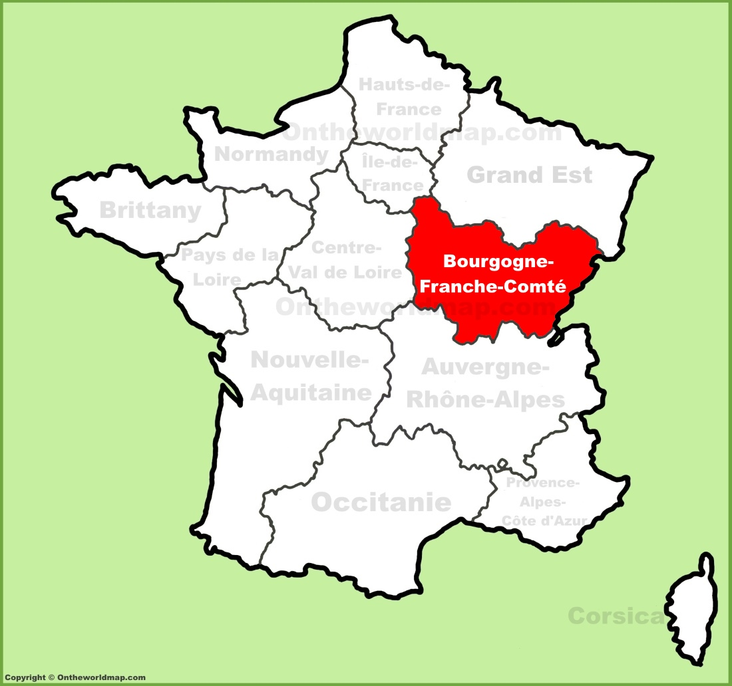
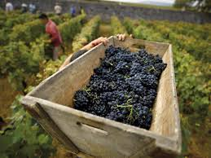
Les vignobles dans la région Bourgogne

Slide 15
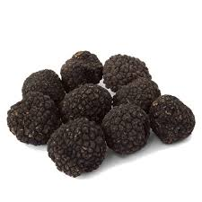
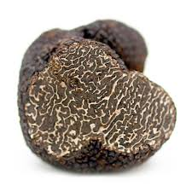
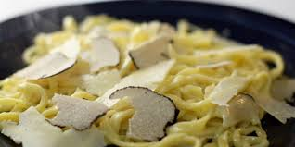
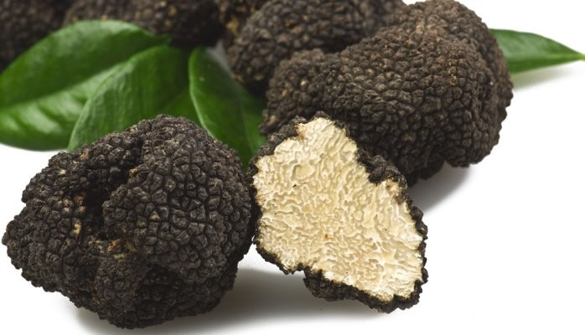
La Truffe (truffles)

Slide 16
Health benefits of truffles
It is a good source of high protein.
They are low in carbs.(lower proportions of carbohydrates)
They are high in fiber.
They are cholesterol free.
They have vitamin D.
(truffle hunt video)

Slide 17
Agriculture in France
Self-sufficient in basic food production
Chief agricultural exports are wheat, sugar and beef.
France- the European Union leader in food exports.
Northern France characterized by wheat farms.
Dairy ,pork,poultry and apple in the western France.
Beef production in central France.
Production of corn, fruits, vegetables and wine ranges from central to southern France.

Slide 18
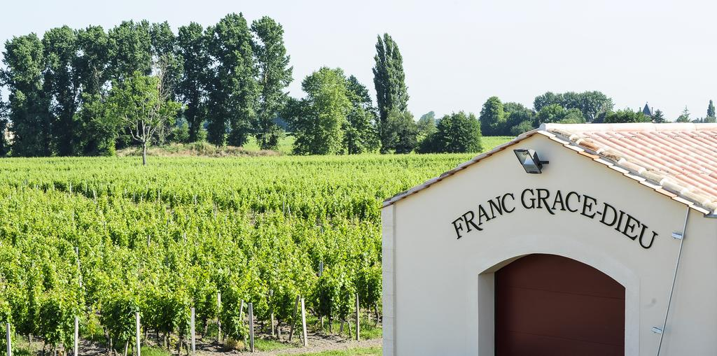
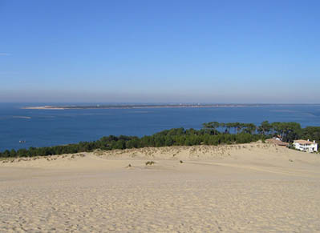
Campagne tourism

Slide 19
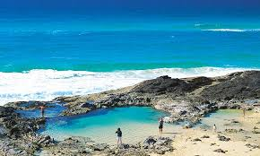
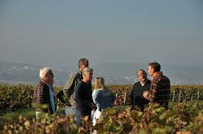
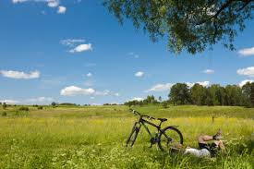
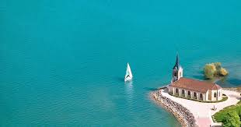
Campagne tourism ..continued…..

Slide 20
Teletravail pour échapper la pollution:

Slide 21
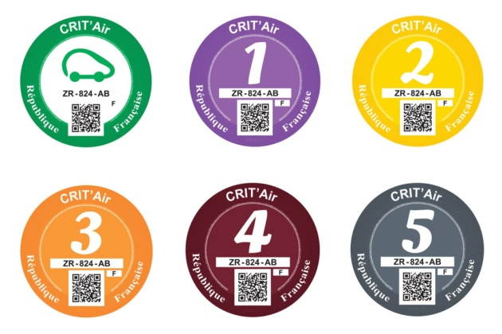
Pollution control : vignette crit'air
All cars travelling in the cities of Paris, Lyon or Grenobles are now required to carry anti-pollution stickers which indicate the age and ‘environmental classification’ of the vehicle.

Slide 22
La pollution song
La pollution ce n’est pas bon . il faut tous faire attention!
………………….(ecoutez)

Slide 23
Merci!!!
Bonne journée à tous!!!!!

